Slide 1
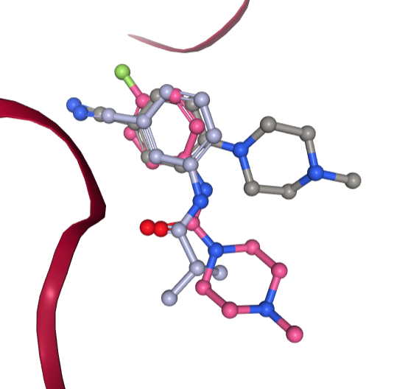
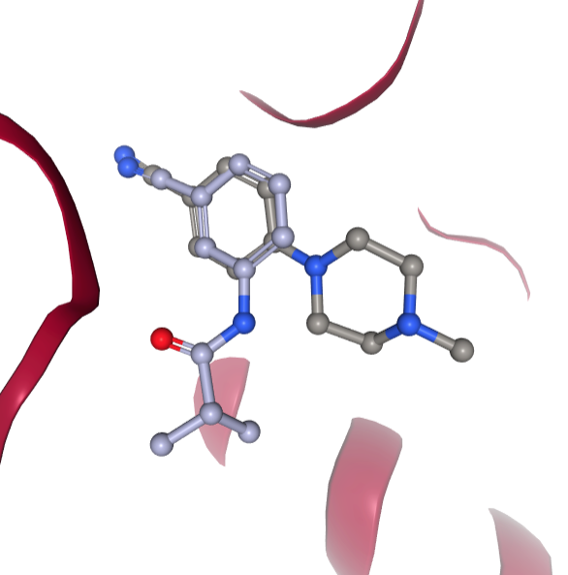
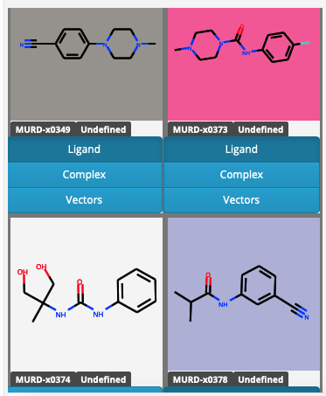
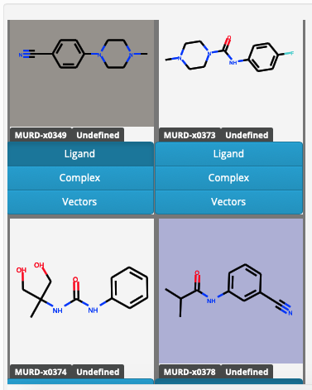
https://fragalysis.diamond.ac.uk/viewer/react/preview/target/MURD
Fragment merging of x0349, x0373 and x0378
Also do ureas (like x0374)
MurD Design 1
Paul Brennan
11-Dec-2018

Slide 2
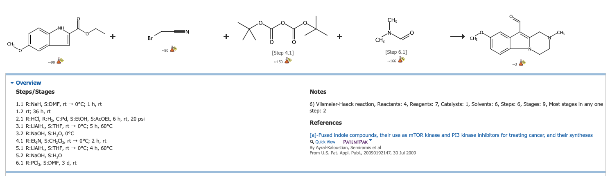
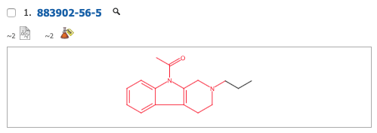
1. Aminomethyl substituted bicyclic aromatic compounds suitable for treating disorders that respond to modulation of the dopamine d3 receptor
By Drescher, Karla; Haupt, Andreas; Unger, Liliane; Turner, Sean C.; Braje, Wilfried; Grandel, Roland
From U.S. (2013), US 8486984 B2 20130716. | Language: English, Database: CAPLUS
2. Preparation of aminomethylbicyclo(hetero)arylbenzenesulfonamides as modulators of the dopamine D3 receptor.
By Drescher, Karla; Haupt, Andreas; Unger, Liliane; Turner, Sean C.; Braje, Wilfried; Grandel, Roland
From PCT Int. Appl. (2006), WO 2006040180 A1 20060420. | Language: English, Database: CAPLUS

